Slide 1
Team no: 35
Name: Farjana Alam
ID: 20101022
ST : Sadiul Arefin Rafi
RA: MD Sabbir Hossain

Slide 2
Znet: Deep Learning Approach for 2D MRI Brain Tumor Segmentation
Publisher: IEEE
Date of Publication: 23 May 2022

Slide 3
Objectives
Proposing a novel deep learning approach called Znet for segmenting 2D brain tumors in MR images
Evaluating the performance of the proposed approach on a public benchmark dataset based on The Cancer Genome Atlas Low-Grade Glioma (TCGA-LGG)
Demonstrating the potential of the proposed approach to assist in accurate diagnosis, prognosis, and medical treatment technologies for brain tumors.

Slide 4
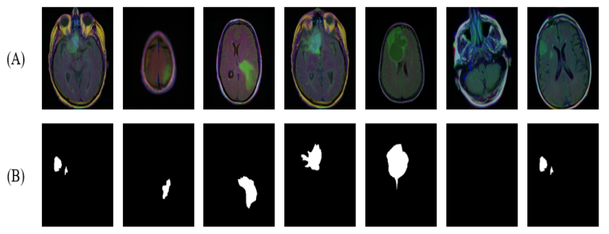
Dataset
The dataset used in the paper is based on The Cancer Genome Atlas Low-Grade Glioma (TCGA-LGG) dataset
The dataset consists of 110 patients with low-grade glioma, including 75 patients for training and 35 patients for testing.
(A) Samples of dataset images (B) the corresponding
annotated ground truth (tumor mask)

Slide 5
Methodology
The authors propose a deep learning-based approach called Znet for brain tumor segmentation.
Znet is a convolutional neural network (CNN) architecture that consists of an encoder-decoder network with skip connections.
Znet is a modified version of the U-Net architecture
The authors used data augmentation techniques to increase the size of the training dataset and improve the generalization of the network.
Result:
Their experimental results showed high values of the mean dice similarity coefficient (dice = 0.96 during model training and dice = 0.92 for the independent testing dataset). Other evaluation measures were also relatively high, e.g., pixel accuracy = 0.996, F1 score = 0.81, and Matthews Correlation Coefficient, MCC = 0.81.

Slide 6
Future work
The authors will report about a prospective improvement and extension of the proposed Znet architecture to enable classification, extraction, parcellation, and prediction of the presence and extent of brain tumors using multichannel 3D MRI volumes.
The authors are working on deep learning strategies to generate realistic high dimensional and multimodal neuroimaging data along with ground truth labels.
The transfer learning approach can be utilized along with the proposed Znet to optimize the training and minimize the costs of developing, validating, and embedding AI techniques in clinical practice settings.
Reference
M. A. Ottom, H. A. Rahman and I. D. Dinov, "Znet: Deep Learning Approach for 2D MRI Brain Tumor Segmentation," in IEEE Journal of Translational Engineering in Health and Medicine, vol. 10, pp. 1-8, 2022, Art no. 1800508, doi: 10.1109/JTEHM.2022.3176737.

Slide 7
Thanks!

